Slide 1
Computer Architecture Concepts
Part 12 – Clocks and flip-flops

Slide 2
Objectives
To consider the importance of timing in digital circuits
To see how a clock signal can be incorporated to synchronise components
To describe a flip-flop as a clocked circuit that can store 1 bit of data (and flip from 0 to 1)

Slide 3
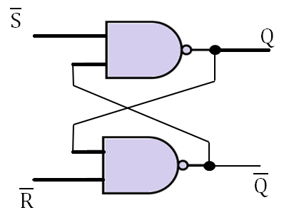
Recap
We have seen that a latch can store 1-bit of data
We know that all data in computers is binary, so we need many bits of data to represent numbers, text, colours etc.

Slide 4
Need for synchronisation
Electrical signals will take time to flow through the components of a computer – known as a signal delay
The signal delay depends on the temperature, minor variations in components and the process being carried out
Note that we don’t see the delay when simulating circuits with Logisim
We need to reliably know when we can use a value
For example, we don’t want to use the result of an addition when not all the bits have finished updating
We don’t want to wait too long, so the timing is important

Slide 5
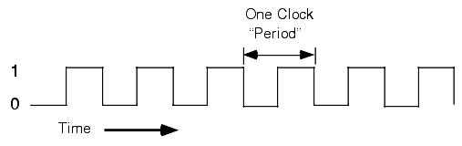
Clock signal
Rising or positive edge
Falling or negative edge
The clock signal oscillates between 0 and 1
It oscillates at a constant rate
The clock period is also known as one cycle
The frequency is the number of cycles per second

Slide 6
Use of clock signal
Synchronise the working of many components
This means the overall system will be more predictable
To minimise the chances of incorrect results when data changes, use a transition between logic levels as the point at which to store the data
The transitions are the rising and falling edges
The clock changes between 0 and 1
We consider the transitions to be instantaneous

Slide 7
Flip-flop
A flip-flop is a component that stores one bit of data and updates its state on a transition of the clock signal
A flip-flop can be built from latches
We will look at a positive edge-triggered flip-flops in the lab and reinforcement exercises

Slide 8
Summary
Latches can store 1-bit of data
Flip-flops also store 1-bit of data but they can be synchronised using a clock signal
This will be important for storing multiple bits

